Slide 1

Cheng, Hua

Slide 2

What - GitHub Copilot is an AI pair programmer trained on natural language text and source code from publicly available sources
How - Install an extension called GitHub Copilot/Copilot Chat on popular IDE (VS Code, IntelliJ)
Why - Mostly improve your productivity and efficiency on your daily work
Retros

Slide 3
Agenda
Use Cases
Live Demo
Limitations

Slide 4

Layout - Layout Base on Native, Layout based on Framework etc
Style - Pure style, UI Libraries etc
Interaction - Code Generation, Structural Data, Common Util Generation, Code Explanation, Code Refactor etc
Use Cases

Slide 5

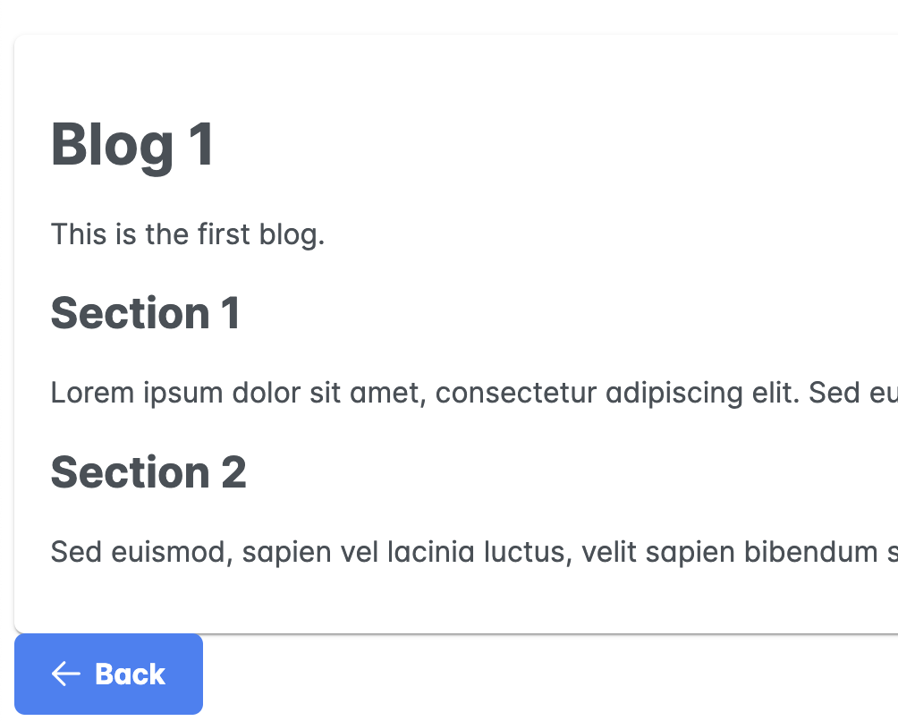
Live Demo
Blog Application
Summary Page
Vertical layout
Full Width, Fixed Height 200px
Title, description, author, star, created time
Detail Page
Back Icon
Transform Markdown into HTML

Slide 6
Limitations
Distracting - as it can suggest many different things, which can be overwhelming, it can lead to a loss of concentration, which can ultimately slow down the coding process
Bad Habits - suggested code is not optimized, inefficient or even insecure, it is not friendly for new programmers who are not ability to identify
Version Detect - suggest code is not well based on existing code of workspace as the trained data is based on 2021 and previous

Slide 7
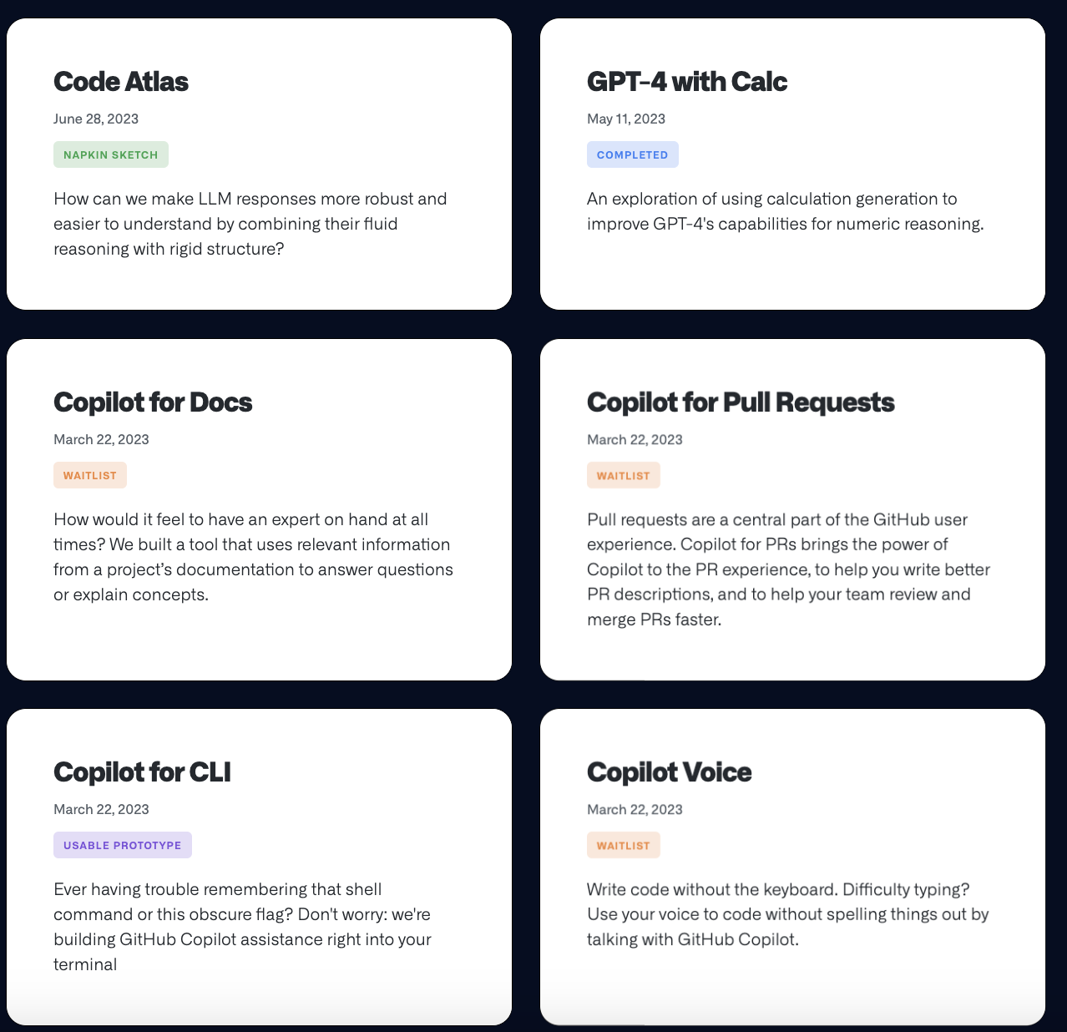
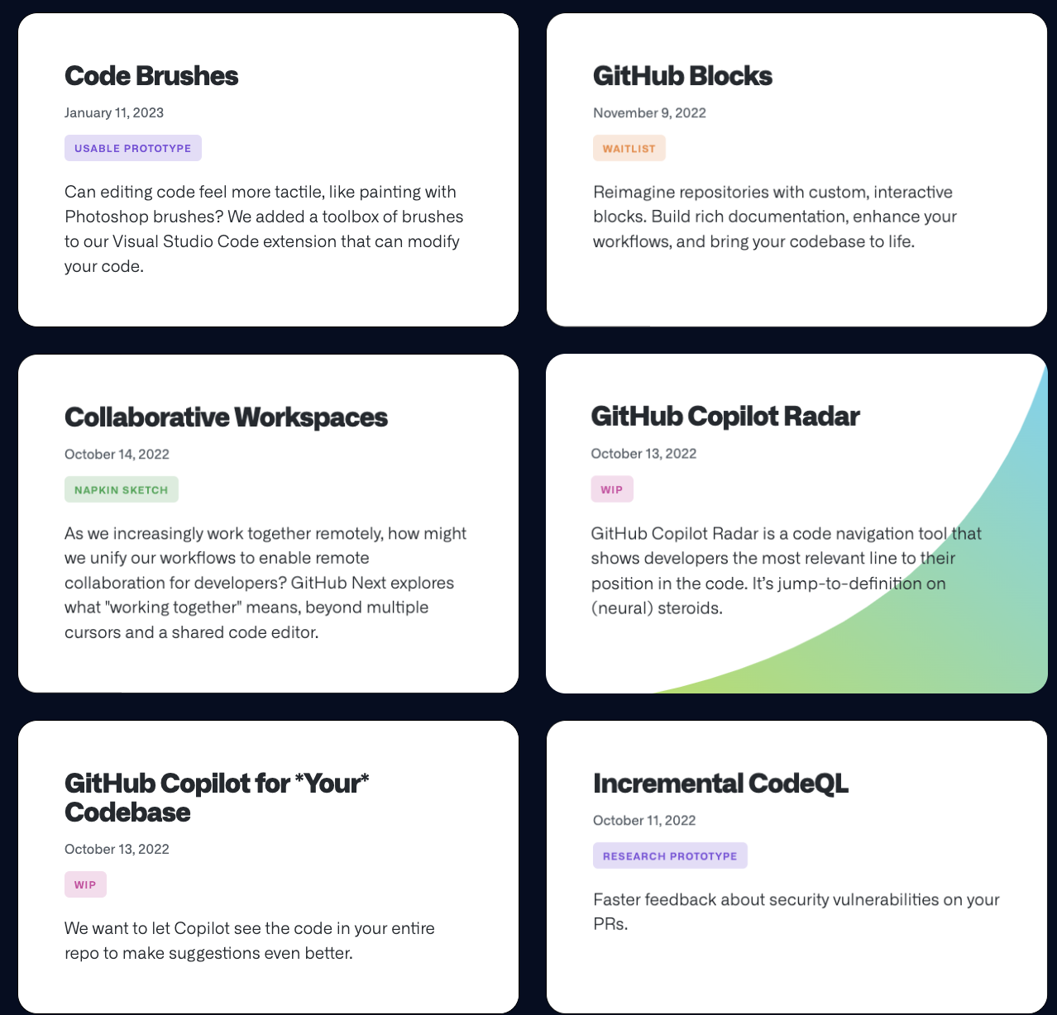
GitHub Next

Slide 8
I have to say Copilot do helpful for our development work but we can’t be fully rely on it.
Just a Copilot!
Conclusion

Slide 9
THANK YOU!

